Slide 1
Twinning in Schools
An introduction for teachers and leaders

Slide 2
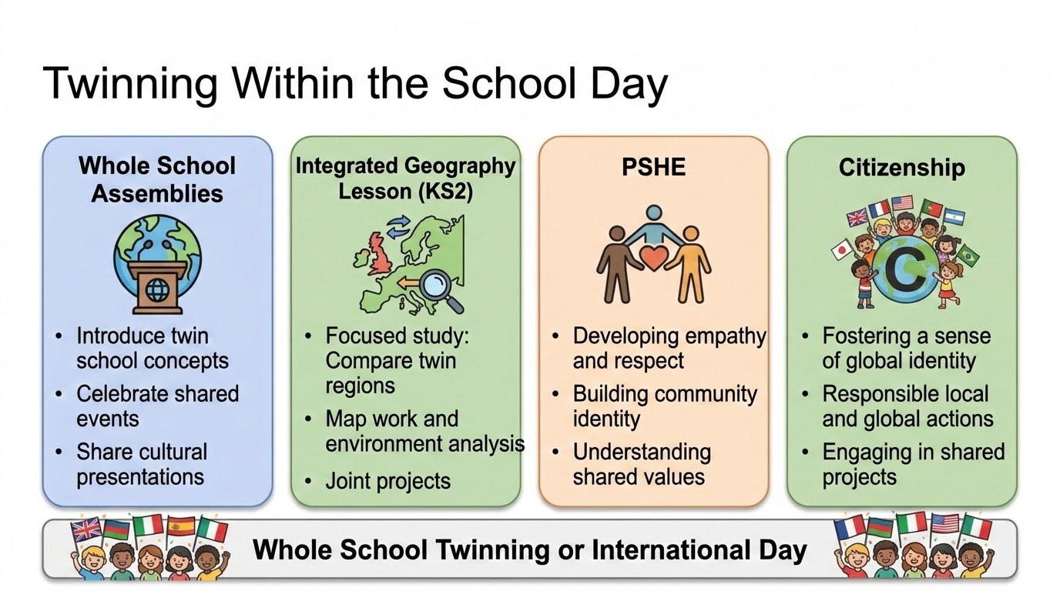

Slide 3
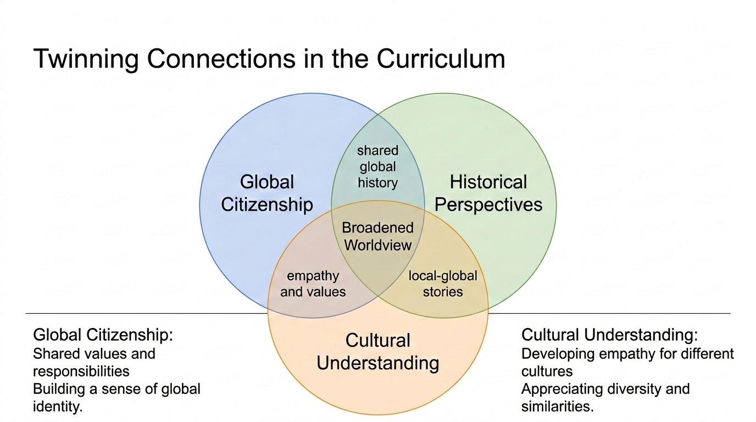

Slide 4
